Slide 1
Fairness-aware contrastive learning on graphs
Xianghe Xu
Graduate Mentor: Jian Kang
Faculty Mentor: Hanghang Tong
University of Illinois at Urbana-Champaign
xianghe3@illinois.edu

Slide 2
Content
Part 1 Background:
The ubiquity of graph data
Contrastive learning
Fairness in machine learning
Part 2 Problem Setting
Part 3 Method
Part 4 Experiment
Part 5 Conclusion and Future work

Slide 3
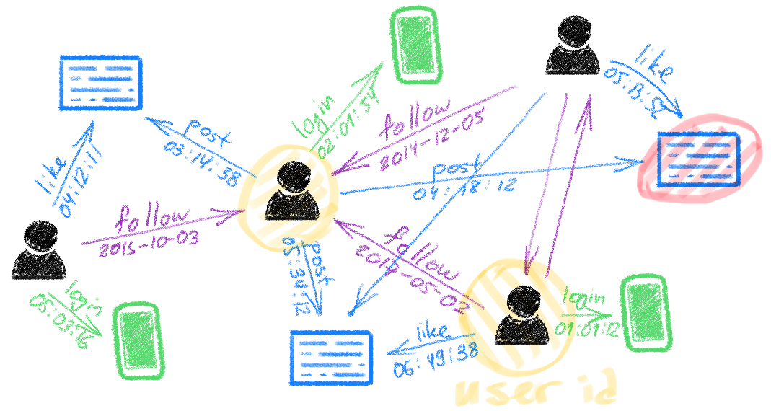
Part 1 Background
The ubiquity of graph data
Consists of complex relationships between objects e.g. sender and post
Reflects many types of interdependencies e.g. follower and followee
Example: social networks
Zonghan Wu, Shirui Pan, Fengwen Chen, Guodong Long, Chengqi Zhang, Philip S. Yu: A Comprehensive Survey on Graph Neural Networks
Michael Bronstein: Deep learning on graphs: successes, challenges, and next steps

Slide 4
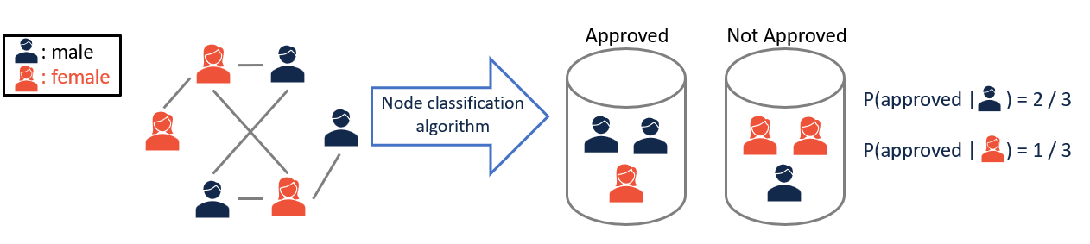
Part 1 Background
Fairness on graph learning
Definition: Lack of favoritism from one side or another
Example: loan approval
One practical problem: Balance utility and fairness
Jian, K, Hanghang Tong: Fair Graph Mining
Fairness in graph mining: a survey

Slide 5
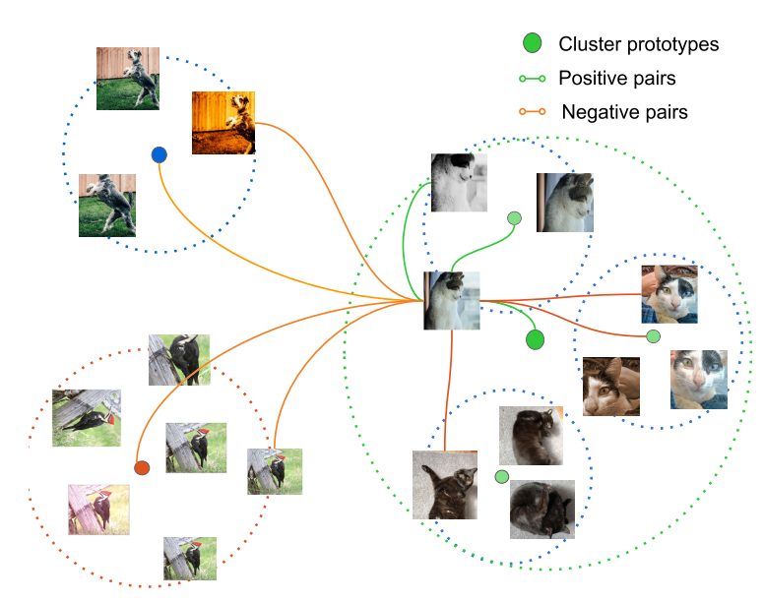
Part 1 Background
Contrastive learning
Goal: learning an embedding that makes
similar sample pairs close to each other
dissimilar pairs are far apart
Contrastive Representation Learning https://lilianweng.github.io/posts/2021-05-31-contrastive/
PHUC H. LE-KHAC, GRAHAM HEALY, ALAN F. SMEATON: Contrastive Representation Learning: A Framework and Review

Slide 6
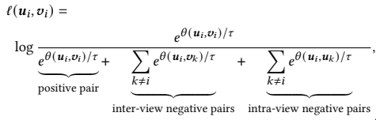
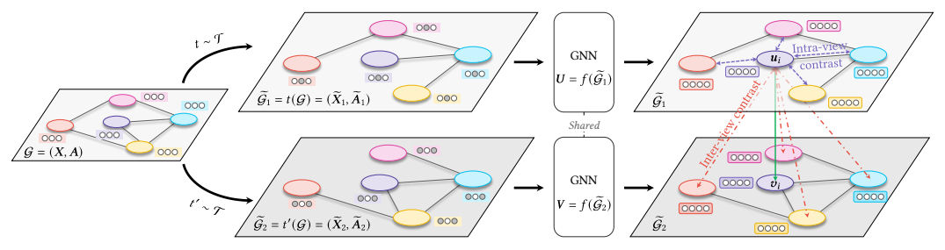
Part 2 Problem setting
GCA (Graph Contrastive Learning with Adaptive Augmentation)
Sample two stochastic augmentation functions
Generate two graph views
Obtain node embeddings
Compute objective function
Negative sampling
Yanqiao Zhu, Yichen Xu, Feng Yu, Qiang Liu, Shu Wu, and Liang Wang: Graph Contrastive Learning with Adaptive Augmentation

Slide 7





Part 2 Problem setting
Fact:
Number of nodes in the sensitive group and the insensitive group are imbalanced
Example: 3 females, 5 males
Evidence: Pokec-z dataset divided by region
4851 nodes vs 2808 nodes
The general problem:
Whether there exists fairness issue in contrastive learning algorithms on graphs and how should we alleviate the issue if it exists?
Yanqiao Zhu, Yichen Xu, Feng Yu, Qiang Liu, Shu Wu, and Liang Wang: Graph Contrastive Learning with Adaptive Augmentation

Slide 8
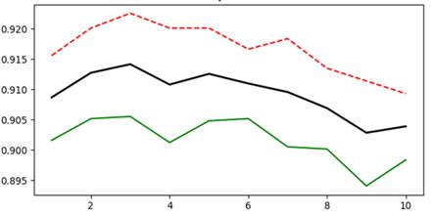
Part 3 Method
Red: ACC of insensitive group
Black: total ACC
Green: ACC of sensitive group
The performance difference does exist!
Here is an intuitive way to sample nodes to make them more balanced: Fair sampling
Notes:
Remain to be polished

Slide 9
Part 3 Method
Input
Fair sampling
Balance the number of sensitive samples and insensitive samples when using the objective function of CL algorithm
Number of sensitive samples: n1
Number of insensitive samples : n2
p = n1/n2
pi ~ Bern(1 - p)
pi is probability of whether dropping ith node in insensitive groups when calculating objective functions in contrastive learning
Training objective function
Notes:
Remain to be polished

Slide 10
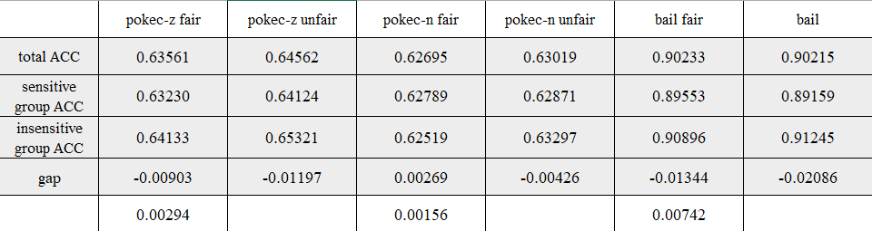
Part 4 Experiment
Node classification
Dataset:
pokec-z, pokec-n, bail
Result:
Fair sampling reduce the gap of accuracy between sensitive groups and insensitive groups
The detailed situation differs by dataset

Slide 11
Part 5 Conclusion and Future work
Conclusion
Problem: fairness in graph contrastive learning
Method: fair sampling method to balance the number of sensitive samples and insensitive samples when calculating the objective function
Result: fair sampling can reduce the gap between the sensitive group and the insensitive group but the effect depends on the dataset
Future work
Analysis the reason of performance difference of fair sampling to GCA on different datasets
Apply other constraints, such as processing the features that have high correlation to the sensitive feature

Slide 12
Thank you

